Slide 1



UNIT 7; Breaking news
Gossip

Slide 2
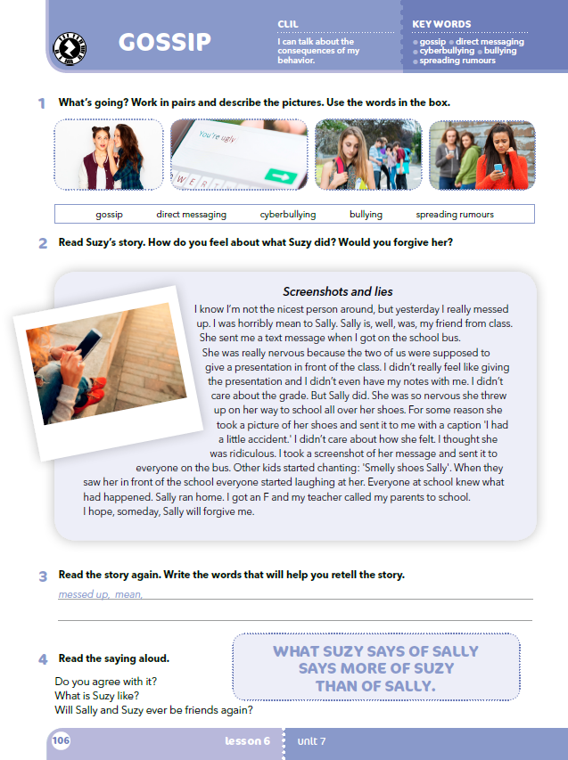
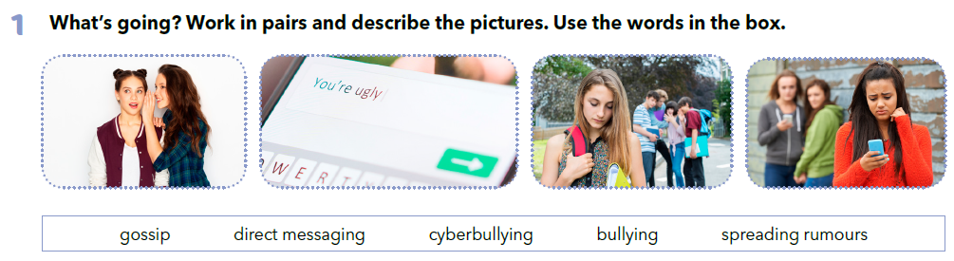
Do you use social networks?
What do you usually do when you are online?
Do you have a lot of friends on your list?
Do you know all of them personally?
Would you call them all your friends?
What do you usually read about?
What do you usually post?
Is every post on this network true?
Are they all friendly?
Have you ever felt bad about something posted on social networks?

Slide 3
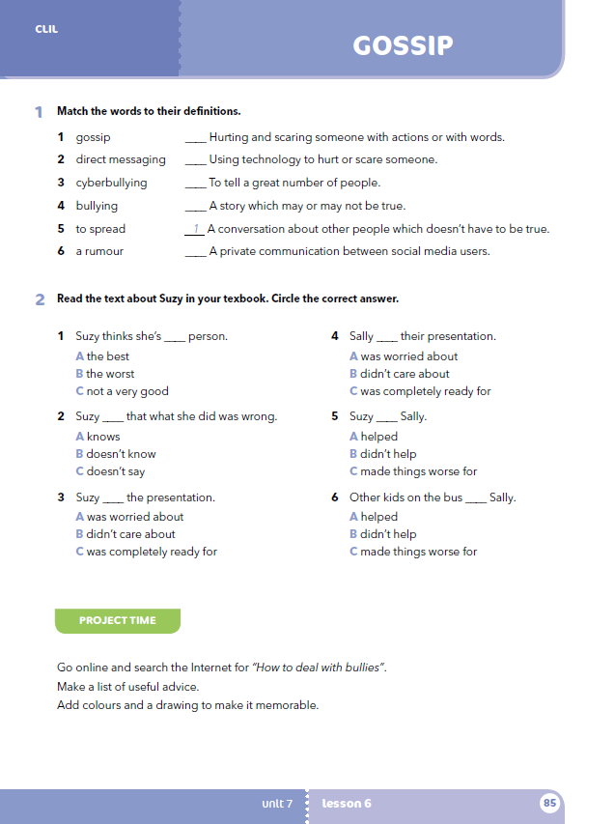
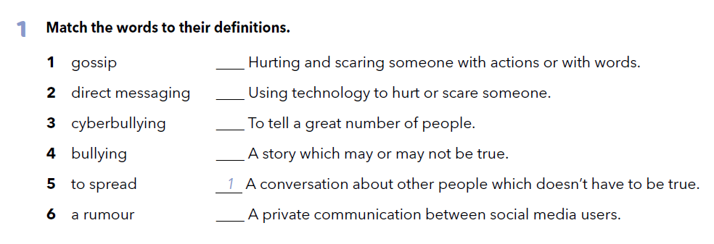
Workbook, p. 85
4
3
5
6
2

Slide 4
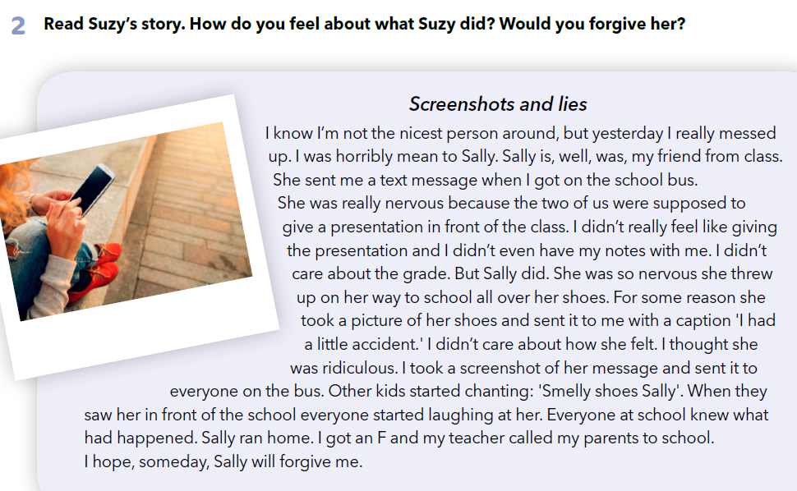
Have you ever been cyberbullied? Have you ever cyberbullied anyone? Do you know what ‘Socrates’ triple filter test’ is?
One day a great philosopher, Sokrates, met his old friend. The friend ran to him and said, Socrates, do you know what I just heard about one of your students?’ Socrates replied, ‘Wait a second. Before you talk to me, let me test what you are going to say.’ So Socrates asked him three questions: 1) Do you know for sure it is true? 2) Do you want to tell me something good? 3) Is the information you want to share useful to me?
How would Suzy respond to ‘Socrates’ triple filter test’?

Slide 5
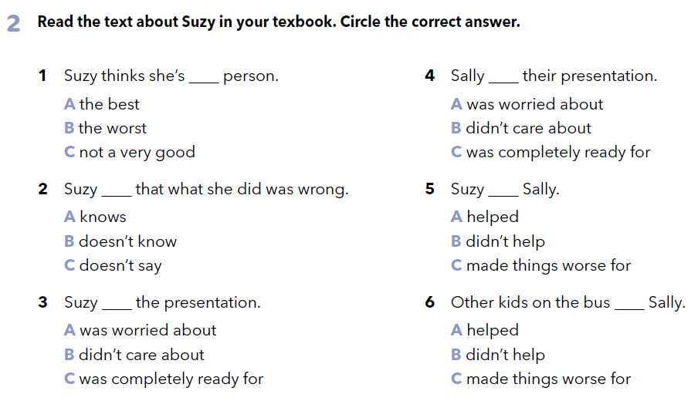

Workbook, p. 85

Slide 6

What is the relationship between the two girls? Why was Sally nervous? Was Suzy also nervous? Did Sally trust Suzy? How did she confide in her? What did Suzy do about it? How did direct messaging lead to cyber bullying? How did Suzy feel in the end?

Slide 7

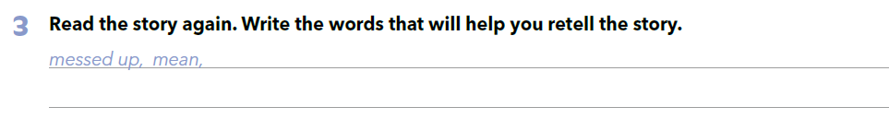
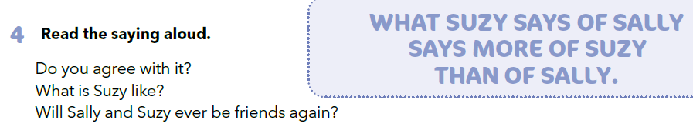

Slide 8

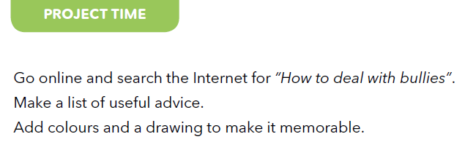
Workbook, p. 85

Slide 9

LEARN MORE
https://www.e-sfera.hr/dodatni-digitalni-sadrzaji/6893a551-7a61-4ac4-b0af-f4efa4c4ea84/
Fake news

